Slide 1
OGC ISG Sprint Kickoff Introduction, Goals, Admin|
Dr. Scott Serich, Leonard Daly
September 1, 2020

Slide 2
Kickoff Agenda
The Kickoff Agenda can be found in the GitHub repository at https://github.com/opengeospatial/OGC-ISG-Sprint-Sep-2020/wiki/Kickoff-Meeting-Agenda .
.

Slide 3
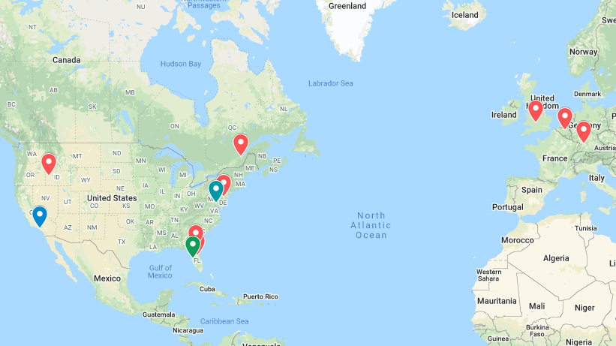
Where in the World

Slide 4
Welcome and Screenshot
Participants please upload a copy of your presentation to your organization’s folder in the GitHub repo at https://github.com/opengeospatial/OGC-ISG-Sprint-Sep-2020/tree/master/Kickoff .
Please activate cameras for a group screenshot (if permitted).
…else post a photo in your repo folder.

Slide 5
Policy Framework & Participant Code of Conduct
This initiative will be conducted within the policy framework [http://www.opengeospatial.org/ogc/policies] of OGC’s Bylaws and Intellectual Property Rights Policy ("IPR Policy"), as agreed to in the Participant’s Membership Agreement, and in accordance with the OGC Innovation Program Policies and Procedures and the OGC Principles of Conduct [https://www.ogc.org/ogc/policies/conduct], the latter governing all related personal and public interactions.
Patent Call: Participant agrees to notify OGC staff if it is aware of any claims under any issued patents (or patent applications) which would likely impact an implementation of the specification or other work product which is the subject of the initiative. Participant need not be the inventor of such patent (or patent application) in order to provide notice, nor will Participant be held responsible for expressing a belief which turns out to be inaccurate. Specific requirements are described under the "Necessary Claims" clause of the IPR Policy.
Participant agrees to refrain from making any public representations that draft Sprint Report (SR) content has been endorsed by OGC before the SR has been approved in an OGC Technical Committee (TC) vote.
Participant agrees to coordinate with OGC and other initiative participants to ensure a shared understanding of required and optional (“stretch goals”) activities and deliverables throughout initiative execution.

Slide 6
Susan Raymie: SOCOM Sponsor Remarks
Susan Raymie: SOCOM Sponsor Remarks

Slide 7
Review of Goals, Activities, Deliverables
Goal: advance the use of relevant OGC and Khronos standards through practical testing of the GeoVolumes draft spec.
Where is the draft spec and what did the Pilot test?
3 Pilot ERs (https://portal.ogc.org/files/?artifact_id=94059#Table4).
Initial sprint scenarios at https://portal.ogc.org/files/?artifact_id=94059#SprintScenario .
Activities (in addition to Kickoff).
Sprint Week September 21-25.
Document findings and recommendations in repo issues as you go, harvest later.
Deliverables
Sprint Report inputs (which parts of the spec did you test, what outcomes, lessons-learned, future recommendations).
At least one short video (~90 seconds).

Slide 8
Leonard Daly: Resources and Tools
Leonard Daly: Resources and Tools

Slide 9
Leonard Daly: Resources and Tools
Document Resources
OGC
Khronos
Collaborative Tools
GitHub
Slack
OGC Portal

Slide 10
Document Resources
OGC Specifications, Document, and Reports
GeoVolume (https://portal.ogc.org/files/?artifact_id=94029)
Pilot Engineering Report
Exec Summary: https://portal.ogc.org/files/?artifact_id=94030
Experiences: https://portal.ogc.org/files/?artifact_id=94028
Other documents – all listed in CfP (https://portal.ogc.org/files/?artifact_id=94059)

Slide 11
Other Documents
Khronos Group – glTF
V2.0 2017-06-09: https://github.com/KhronosGroup/glTF/tree/master/specification/2.0
Continually updated with extensions
Beginning to start ISO ratification process for Publicly Available Specification

Slide 12
Collaborative Tools
GitHub
https://github.com/opengeospatial/OGC-ISG-Sprint-Sep-2020
Must agree to OGC terms before write access
Wiki
Slack
Scott sent invitations
Send request to Scott for additional channels
OGC Portal
Use email list for any correspondence that must have a permanent record.
Ditto for files… upload them to the Portal.

Slide 13
During Sprint
Everything described above
Short everyday meetings
Mon-Thu (Sep. 21-25) 09:30 EDT start time.
~1.5 hours Monday.
Less on Tu-Thu (maybe a standup meeting).
Friday TBD.
Review progress
Need for additional tools
Sprint leadership available

Slide 14
Participant Presentations
Participant Presentations:
CAE, Steinbeis, Helyx, Ecere, Cognitics, Cesium, Hexagon, SimBlocks, InfoDao.
.
.

Slide 15
Wrap-Up and Next Steps
Tech.
Coordination of testing between participants.
Document any dependencies in issues… make sure that there’s at least one server to support your client needs.
Wiki page containing a list to available containers: .
Admin.
Make use of SOFWERX Slack channel?
Participants be sure you have access to the GitHub repo.
Create new Issues for any formal questions, suggestions, initial findings, future recommendations, etc. These will be harvested later for Sprint Report inputs.
Wiki pages may be used to create more lengthy documents.
Quick-hitting Q&A can go through Slack.
Should we set up a G2M for Tuesday Sep. 8 at 09:30 EDT?
AOB?

Slide 16
The end.

